Slide 2
Bladder Cancer Support Group Inaugural Meeting
Suzanne B. Merrill, M.D., F.A.C.S.
Urologic Oncologist
Colorado Urology

Slide 3
Why a Support Group?
Brings people with similar experience together
Creates a sense of belonging
Reduces feelings of isolation
Can empower individuals—regain back control
Improves coping and adjustment
Enhances understanding of what to expect
Gain practical advice + medical information
Creates a Community:
Together we are Stronger

Slide 4
Outline
Current bladder cancer statistics
The numbers and who is at risk
New FDA approved therapeutics & diagnostics
Non-muscle invasive + Muscle invasive disease
New frontier—clinical trials
Non-muscle invasive + Muscle invasive disease

Slide 5
Bladder Cancer Statistics
Over 600,000 cases diagnosed worldwide
In 2023…
Over 82,200 people in the U.S. were diagnosed with bladder cancer
~225 people per day heard the words “You have bladder cancer”
16,700 deaths attributed to bladder cancer

Slide 6
Bladder Cancer Statistics
Currently…
Over 700,000 people in the U.S. are living with bladder cancer
More people than the population of Wyoming

Slide 7
Bladder Cancer Statistics
In Colorado….1,220 new cases in 2023

Slide 8
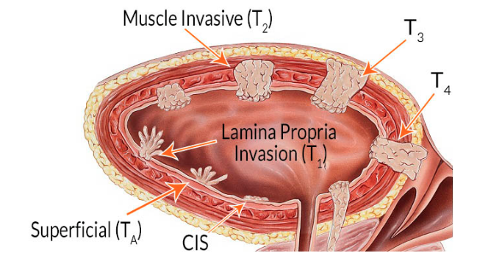
Why…Bladder Cancer?
Bladder cancer cases are rising…
Estimated increase of %1.35 over 2022
With the aging U.S. population →
Projected 68% increase by 2030

Slide 9
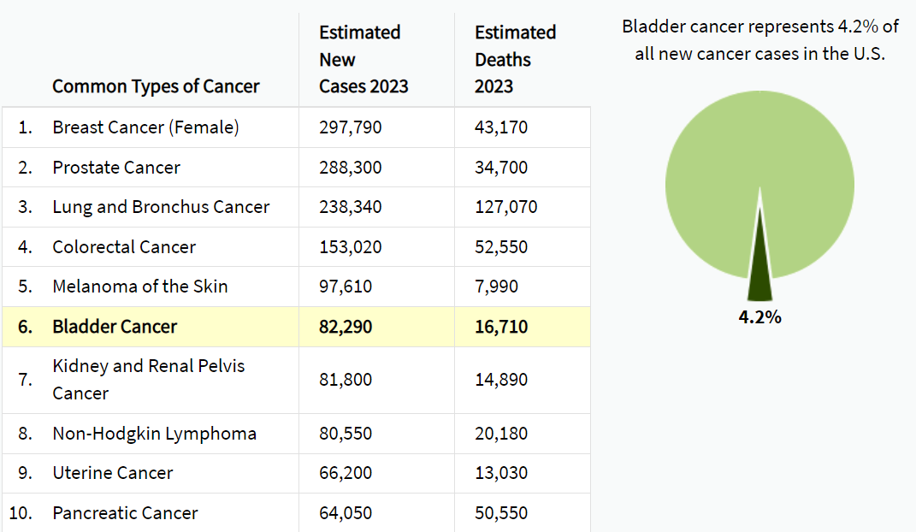
Bladder Cancer = 6th Most Common Cancer
4th most common cancer in men
SEER Cancer Statistics 2023

Slide 10
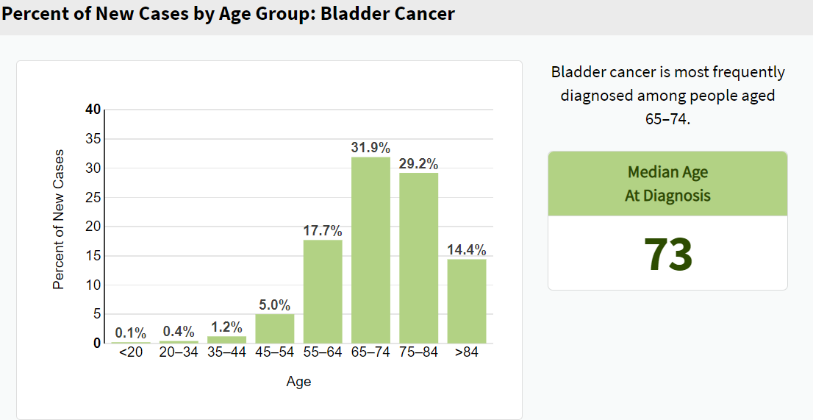
Most Common at Ages: 65-74 yrs
Over 90% of cases in age >55yrs
Notes:
Over 90% of cases are over age 55

Slide 11
Bladder cancer disproportionately affects older adults
Among age >80 years
179 new cases per 100,000
High rates of multimorbidity
Median 8 chronic conditions
Bladder cancer deaths are highest amongst age 85+
> 60% of deaths occur over 75 yrs
32% of deaths are in 85+
Nielsen ME, et al. Cancer 2014; 120(1); Smith BD, et al. JCO 2009; 27(17); Garg T et al. J Urol 2018; 199(2); SEER cancer statistics 2021.

Slide 12
Gender Predilection

Slide 13
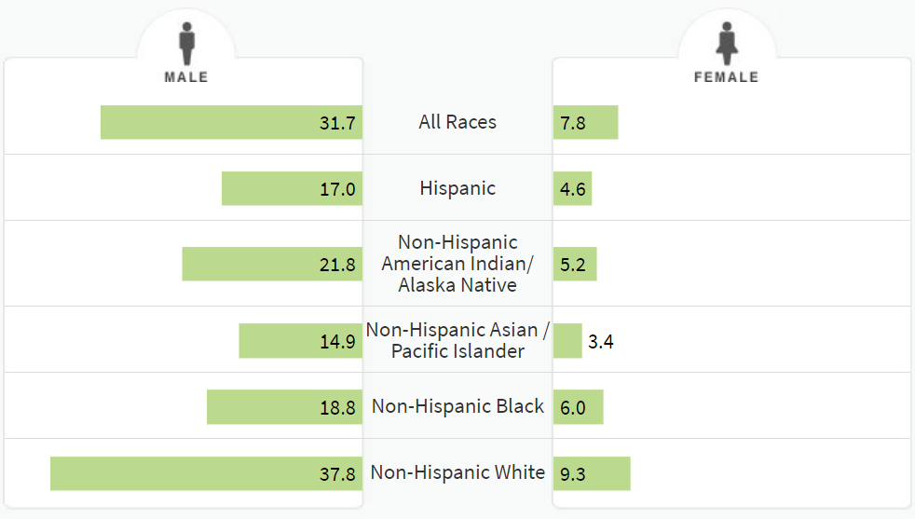
New Cases of Bladder Cancer by Gender/Race

Slide 14
Bladder Cancer Risk Factors
Accounts for 47% all cases
Notes:
Smoking accounts for 47% of all cases

Slide 15
New FDA Approved Therapeutics & Diagnostics
Non-Muscle Invasive & Muscle Invasive Bladder Cancer

Slide 16
Stages of Bladder Cancer

Slide 17
Superficial Bladder Cancer (Non-Muscle Invasive Bladder Cancer)
> 60% patients are diagnosed at this stage
Risk of recurrence
Up to 61% at 1 year and 78% at 5 years
Risk of progression
Up to 17% at 1 year and 45% at 5 years
10%
70%
20%

Slide 18
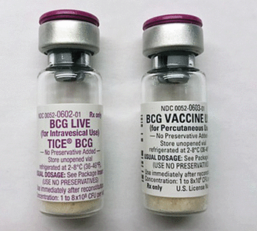
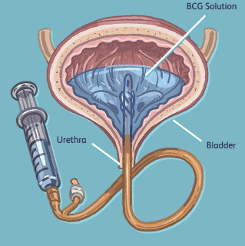
Traditional Agents Treatment of Superficial Bladder Cancer
Intravesical Agents—mainstay of therapy
Bacillus Calmette-Guerin (BCG)
Supply shortage continuing
CR up to 80%, but not durable
Gemcitabine
Gemcitabine/Docetaxel
46% RFS at 2 years
Mitomycin
BCG Unresponsive disease
Occurs in 50% of high risk patients

Slide 19
New FDA Approved Treatment of BCG Unresponsive NMBIC
Nadofaragene firadenovec (Adstiladrin)—adenovirus vector gene based therapy (IF2b)
53% CR at 3 months—durability ~10 months
Intravesical--given every 3 months x 4 years
N-803 (Anktiva) +BCG –IL 15 superagonist (May/June approval)
55% CR at 3 months—durability ~27 months
Intravesical--given like BCG (1x week/6 weeks)
Pembrolizumab—PD-1 inhibitor
41% CR at 3 months—durability ~24 months
IV therapy--every 3-6 weeks x 2 years

Slide 20
New Technology for Superficial Bladder Cancer
Blue light cystoscopy with Cysview (intravesical agent)

Slide 21
Advantages of Enhanced Cystoscopy
Improves detection of tumors (~25%)
At diagnosis
During follow-up
Decreases rate of recurrence (~11%)
May decrease rate of progression
Narrow Band Imaging (NBI)

Slide 22
Invasive Bladder Cancer
Tumor grows into muscle layer or beyond
33% patients are diagnosed at this stage

Slide 23
Treatment of Invasive Bladder Cancer (Muscle Invasive Bladder Cancer)
Multidisciplinary care
Urologic Oncologist
Medical Oncologist
Radiation Oncologist
Options:
Chemo + Surgery
Survival advantage
Chemo + Radiation
Clinical trials (bladder sparing)
Immunotherapy + Intravesical therapy

Slide 24
Surgical Treatment Invasive Bladder Cancer

Slide 25
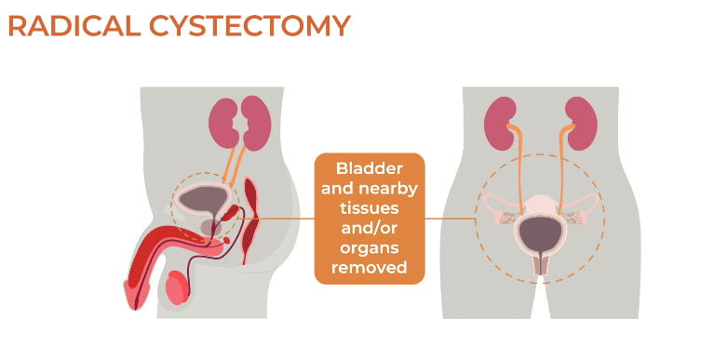
Surgical Treatment Invasive Bladder Cancer
Quality of life improvements:
Men → nerve sparing to preserve erectile function
Females → Vaginal sparing and ovary sparing (premenopausal)

Slide 26
Surgical Treatment Invasive Bladder Cancer

Slide 27
Surgical Treatment Invasive Bladder Cancer

Slide 28
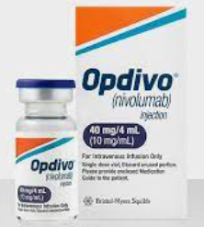
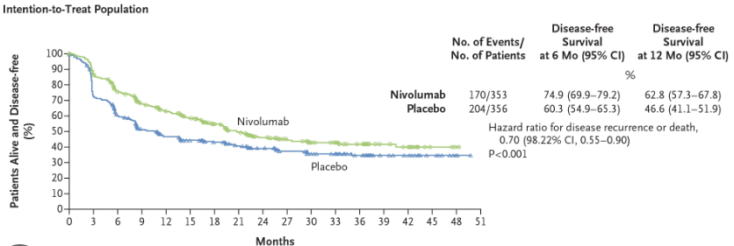
New FDA Approved Treatment of Persistent Invasive Disease After Surgery
For patients after cystectomy with:
pT2 or worse disease (with neoadjuvant chemo)
OR
pT3 or worse disease (without neoadjuvant chemo)
Nivolumab (Opdivo)—PD-1 inhibitor
30% risk reduction of BC recurrence/death (HZ 0.7, 95% CI 0.57-0.86)
IV therapy--every 2-4 weeks x 1 year

Slide 29
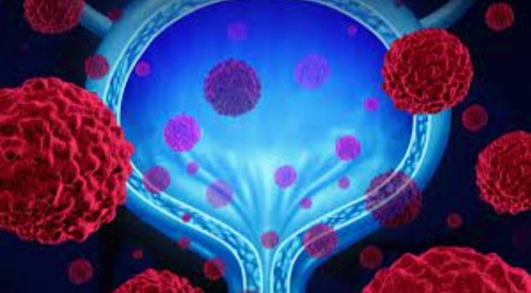
New Frontier: Clinical Trials
Critical component when standard of care treatments are not viable
Non-Muscle Invasive Bladder Cancer
SunRISe 1 –BCG unresponsive high risk CIS +/- pTa disease
TAR-200 (intravesical slow release Gemcitabine) + Cetrelimab
SunRISe 3 –BCG naïve high risk disease
TAR-200/Cetrelimab vs. BCG alone
Keynote 676 –BCG naïve or persistent disease
BCG +/- Pembrolizumab
Notes:
Certainly an important element for a comprehensive bladder cancer program is ensuring our patients have access to clinical trials. Clinical trials are a critical….

Slide 30
New Frontier: Clinical Trials
Critical component when standard of care treatments are not viable
Muscle Invasive Bladder Cancer
SunRISe 2 –unfit or unwilling for cystectomy
TAR-200 + Cetrelimab vs. Chemotherapy/Radiation
SunRISe 4 –ineligible for Cisplatin based chemotherapy
Cetrelimab +/- TAR-200 prior to cystectomy
Notes:
Certainly an important element for a comprehensive bladder cancer program is ensuring our patients have access to clinical trials. Clinical trials are a critical….

Slide 31
www.coloradouro.com
Thank you!

Slide 32
Bladder Cancer Support Group Colorado Urology
Semi-annual to quarterly meetings
Share your email
Continue the community support throughout the year!
Meeting topics
What do you want to learn about?
Upcoming clinical trials and therapeutics
Ostomy tips/tricks
Pelvic floor physical therapy
Ways to mitigate side effects of intravesical therapy
Novel treatments for metastatic bladder cancer

