Slide 1
Bladder Cancer Support Group
2nd Semi-Annual Meeting
Guest Speaker: Dr. Jason Greenfield
Men’s Sexual Health Specialist
Suzanne B. Merrill, M.D., F.A.C.S.
Urologic Oncologist

Slide 2
Why a Support Group?
Brings people with similar experience together
Creates a sense of belonging
Reduces feelings of isolation
Can empower individuals—regain back control
Improves coping and adjustment
Enhances understanding of what to expect
Gain practical advice + medical information
Creates a Community:
Together we are Stronger

Slide 3
Outline
Erectile dysfunction: risk factors & treatments
What we can do to preserve function
Colorado Urology’s Bladder cancer team
Update on novel therapeutics & clinical trials
Non-muscle invasive + Muscle invasive disease
Bladder Cancer Advocacy Network (BCAN)—Walk to End Bladder Cancer
Denver—April 27, 2024

Slide 4
What is ED?
ED is the consistent inability to sustain an erection sufficient for sexual intercourse
ED can be:
A total inability to achieve an erection
An inconsistent ability to achieve an erection rigid enough for penetration
A tendency to sustain only brief erections

Slide 5
Facts about Erectile Dysfunction (ED)
Most men with ED still have the ability to have an orgasm and father a child, but often have difficulty doing these things because they can’t get or sustain an erection
ED is not normal, and is by no means an inevitable consequence of aging
In most cases, ED can be overcome
Approximately 30 million American men suffer from ED
1 in 4 men experience some form of ED
Notes:
ANIMATION:
Click to build first graphic:
Worldwide, 55 million men suffer from incontinence.²⁹
5 million men in the United States suffer from incontinence.²⁹
Prostate Cancer does not create the problem, the treatments do!
Click to build second graphic:
Approximately 186,000 men are diagnosed each year with prostate cancer.¹
Of those, more than 155,000 have a prostatectomy²
About 5-65% of these men will have incontinence³
In many cases men with incontinence are also likely to have Erectile Dysfunction

Slide 6
Causes of ED
Research has shown that greater than 80% of men suffering from ED can trace it to a physical problem or disorder
For most men, ED is caused by a physical problem or disorder
Once identified, proper treatment can be recommended to help return them to a satisfying sex life
ED can be caused by physical disorders such as:
Injury (i.e. brain or spinal cord)
Disease (i.e. diabetes or heart disease)
An operation (i.e. prostate gland removal)
Substance use (i.e. tobacco, drugs, alcohol or medications)

Slide 7
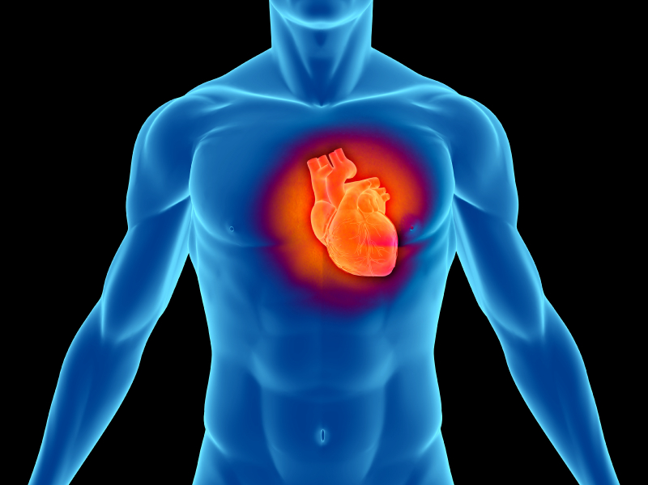
ED can be a marker for cardiovascular disease (CVD)
The penis is a vascular organ
Loss of erectile rigidity is the earliest sign of endothelial dysfunction
Endothelial dysfunction is an early marker for cardiovascular disease
Because the arteries to the penis are smaller – the earliest markers for CVD are apparent in the penis

Slide 8
Risk factors for ED
AGING
CHRONIC DISEASES
Hypertension | Diabetes | Depression | Cardiovascular disease
MEDICATIONS
Antihypertensives : Thiazide diuretics | Beta-blockers
LIFESTYLE
Stress | Alcohol abuse | Smoking

Slide 9
Aging
RISK FACTORS FOR ED
The process of aging increases your risk for ED because of:
Progressive decline in sexual physiologic function
Increased prevalence of chronic diseases
Psychological issues
Relationship and partner issues
Most Frequent Reasons for Office Visits to Primary Care Physicians: Patients Age 45 to 64
Essential hypertension
Diabetes
General medical examination
Disorders of lipid metabolism

Slide 10
Diabetes and Hypertension
RISK FACTORS FOR ED
Factors impacting ED in patients with diabetes
Increased age
Increased duration of diabetes
Poor glycemic control (HbA1C)
Complications of diabetes (e.g., neuropathy or vascular disease)
Hypertension
104 hypertensive patients (aged 34-75 years)
68.3% reported ED
45.2% reported severe ED
In this study, ED prevalence correlated to underlying vascular disease

Slide 11
Chronic Disease
RISK FACTORS FOR ED
Chronic Disease | Increased ED Risks
Diabetes | ×4.1
Prostate disease | ×2.9
Peripheral vascular disease | ×2.6
Cardiac problems | ×1.8
Hyperlipidemia | ×1.6
Hypertension | ×1.6

Slide 12
Prostate/Bladder Cancer
RISK FACTORS FOR ED
Prostate and Bladder Cancer itself will not cause ED but treatment options may affect your erections by impacting nerves or blood flow
Prostate Cancer treatment options correlated to ED:
Radical (cysto)prostatectomy
During the process the nerve bundles may be damaged
Radiation therapy
Over time, the radiation therapy may damage blood vessels to the penis, preventing blood flow

Slide 13
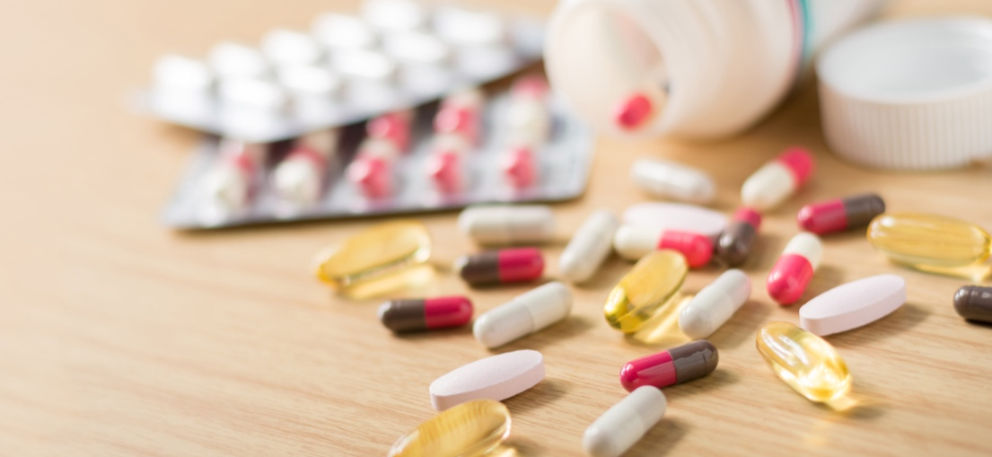
Smoking and Medications
RISK FACTORS FOR ED
Smoking
Smoking increases risk of moderate-to-complete ED 2-fold
Association between smoking and ED is likely due to impairment of endothelium-dependent smooth muscle relaxation
Lower prevalence of ED in former smokers compared with current smokers
Medications
Thiazide diuretics
Beta-blockers

Slide 14
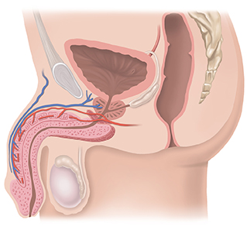
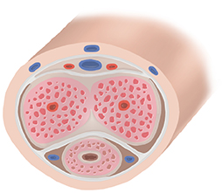
How does an erection occur?
An erection is an involuntary reaction in response to sexual stimulation and excitement
Sexual stimulation and excitement cause the brain, nerves, the heart, blood vessels and hormones to work together to produce a rapid increase in the amount of blood flowing to the penis

Slide 15
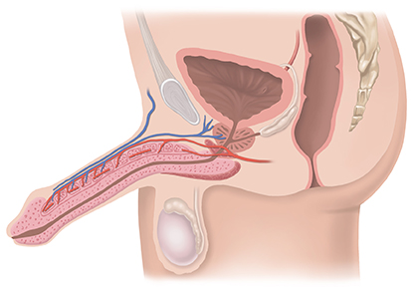
How does an erection occur?
The blood becomes trapped and held in the two spongy chambers in the shaft of the penis

Slide 16
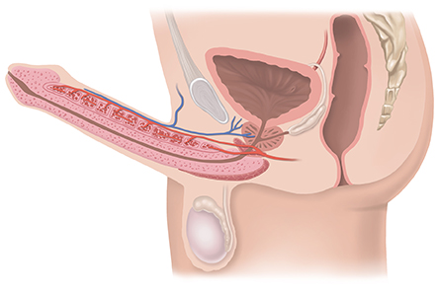
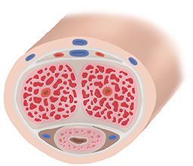
How does an erection occur?
As the chambers rapidly fill with blood, they expand, and the penis becomes firm and elongated. The result is an erection

Slide 17
Treatment Options for ED

Slide 18
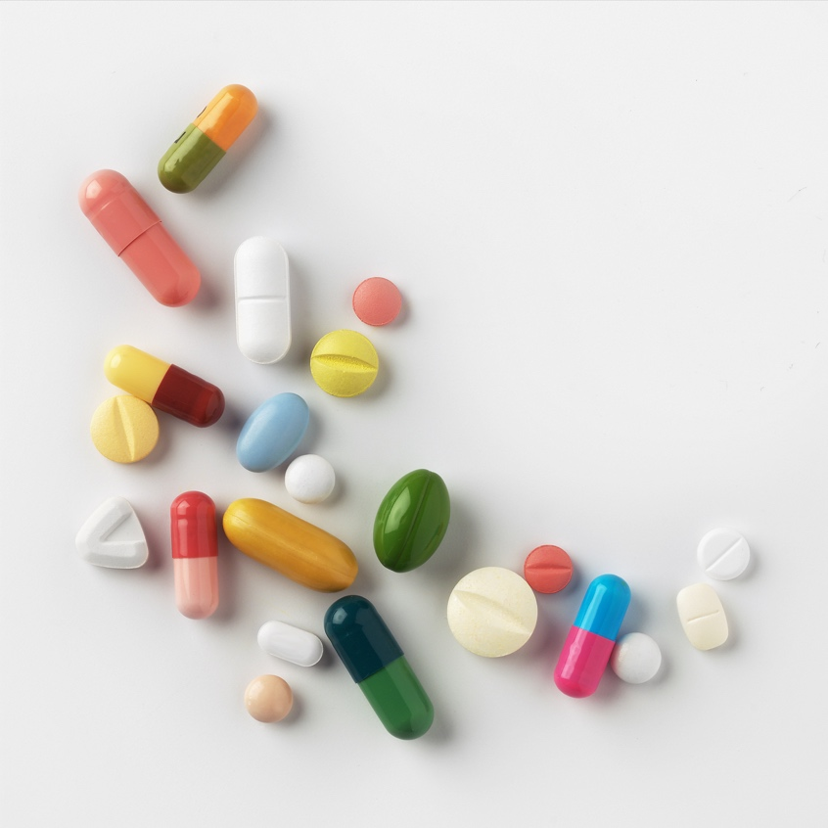
Oral Drug Therapy
Drug therapy includes prescription medication (PDE5 inhibitor):
Viagra® (sildenafil citrate)
Cialis® (tadalafil)
Levitra® (vardenafil hydrochloride)
These pills may help achieve erections in response to sexual stimulation:
Do not provide automatic erections like injection drugs
Not effective in approximately 30% of cases
Must take at least ½ hour to one hour before anticipated sexual activity
Potential side effects:
Headaches
Facial blushing
Upset stomach
Mild and temporary visual effects
Back pain/muscle aches

Slide 19
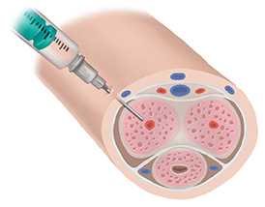
Penile Injection Therapy
ADVANTAGES
DISADVANTAGES
Onset of erection within 5-20 minutes
Risk of erection lasting 4 hours or more (priapism)
Possible bleeding at injection site
Possible pain at injection site
Requires training
Bruising, prolonged erection
Can cause Peyronie’s disease (curvature of penis)
Poor long-term tolerability
Fear of sticking needle in penis

Slide 20
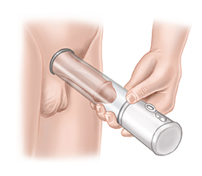
Vacuum Erection Devices
ADVANTAGES
DISADVANTAGES
On-demand use
Non-invasive
Safe and effective
Drug free
Cost effective
Therapeutic benefits
Training available
Erection is not warm to the touch
Learning curve
Inconsistent ejaculation

Slide 21
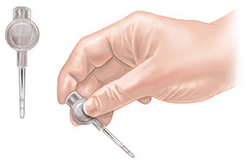
Insertable drugs
Urethral Suppository
Why choose a Transurethral System
An applicator containing a small pellet (suppository) is inserted in the urethra and the pellet is released.
Pellet dissolves and increases blood flow creating an erection.
Lack of response to oral therapy
Contraindications to specific oral drugs
Adverse reactions/intolerance to oral drugs
DISADVANTAGES
Side effects like pain, burning, groin pain

Slide 22
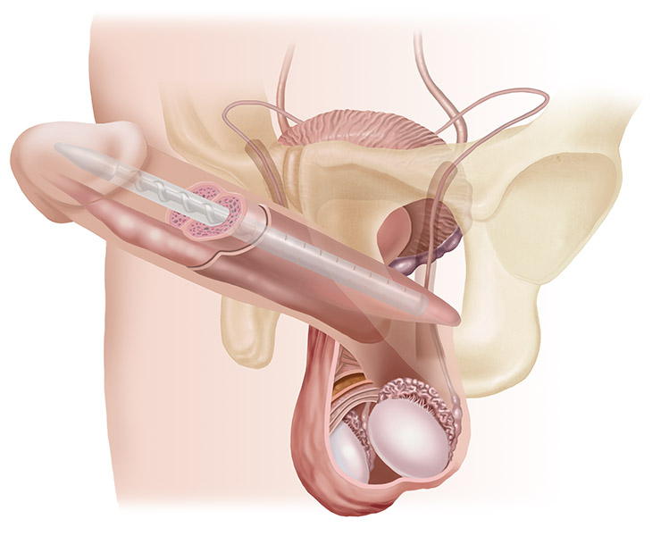
Malleable Penile Prosthesis Implant
ADVANTAGES
Easy for you or your partner to activate
Good option for men with limited dexterity
Totally concealed in body
Least expensive prosthesis
DISADVANTAGES
Stays firm when not in erect position

Slide 23
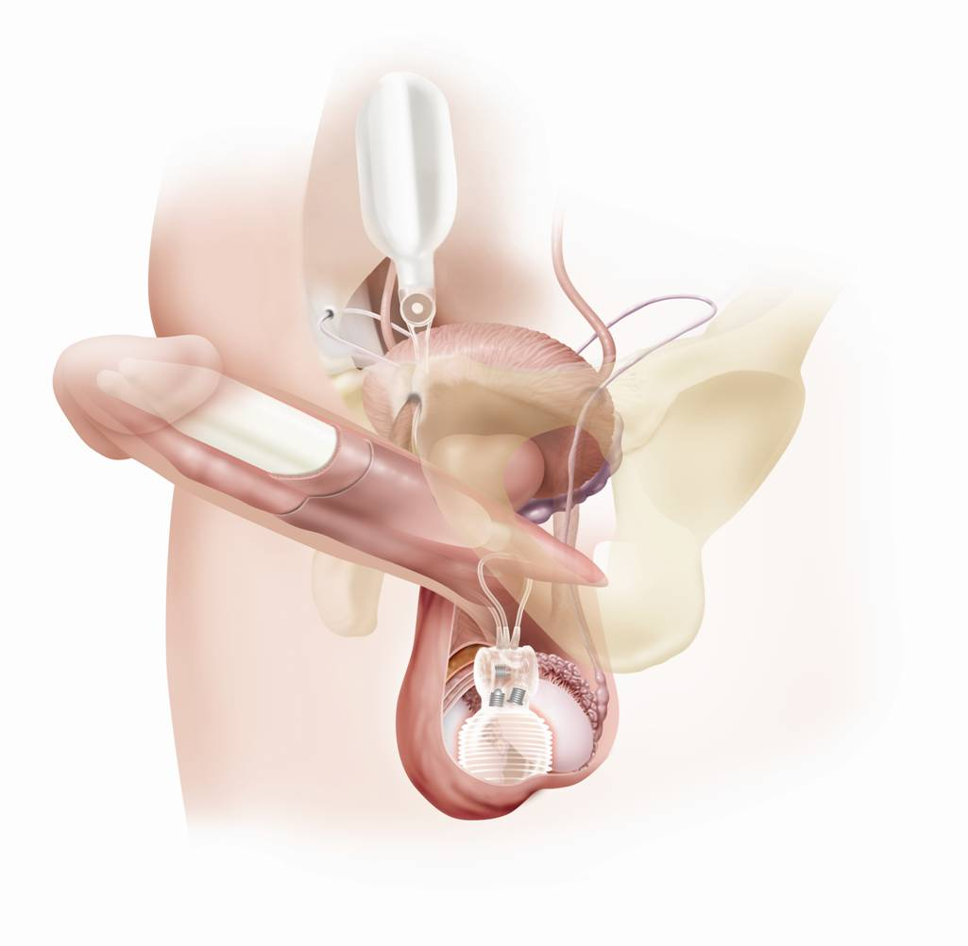
Inflatable Penile Prosthesis
ADVANTAGES
Easy to use
One-step deflation
Totally concealed in body
Natural flaccidity compared to non-inflatable implants
Acts and feels more like a natural erection
Expands girth of the penis
Feels softer and more flaccid when deflated

Slide 24
Risks of Penile Prosthesis
Implantation of both a malleable and inflatable penile prosthesis requires surgery. Every surgical treatment has potential risks, including penile implants:
Infection
May make latent natural erections, as well as other treatment options impossible
Erosion (wearing away of the tissue next to the implant)
Migration (unwanted movement of the device within the body)
Chronic pain
Device malfunction

Slide 25
Restorative/Regenerative Therapies
Examples:
Stem cell injection
PRP injection
LiSWT
Other shockwave
None are FDA approved
Data is limited, mostly shows safety rather than efficacy
Data especially limited in patients with neurogenic causes (such as nerve injury from surgery)

Slide 26
Interested in an Appointment? Dr. Greenfield
We will contact you!
Name + DOB

Slide 27
Colorado Urology’s Bladder Cancer Team
Lauren Sheffield, PA
Suzanne Perez, RN
Nurse Navigator
Juliana White, MA
Madison Mousaw
Appointment Scheduling
Dawn Hempel
Surgery Scheduling

Slide 28
New FDA Approved Therapeutics & Diagnostics
Non-Muscle Invasive & Muscle Invasive Bladder Cancer

Slide 29
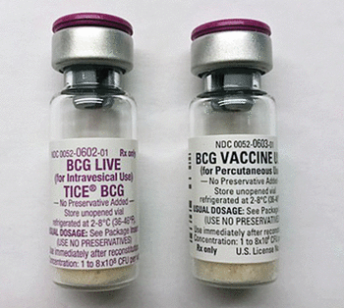
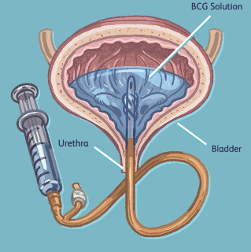
Traditional Agents Treatment of Superficial Bladder Cancer
Intravesical Agents—mainstay of therapy
Bacillus Calmette-Guerin (BCG)
Supply shortage continuing but lessening
CR up to 80%, but not durable
Gemcitabine
Gemcitabine/Docetaxel
46% RFS at 2 years
Mitomycin
BCG Unresponsive disease
Occurs in 50% of high risk patients

Slide 30
New FDA Approved Treatment of BCG Unresponsive NMBIC
Nadofaragene firadenovec (Adstiladrin)—adenovirus vector gene based therapy (IF2b)-not widely available
53% CR at 3 months—durability ~10 months
Intravesical--given every 3 months x 4 years
N-803 (Anktiva) +BCG –IL 15 superagonist-not on market
55% CR at 3 months—durability ~27 months
Intravesical--given like BCG (1x week/6 weeks)
Pembrolizumab—PD-1 inhibitor
41% CR at 3 months—durability ~24 months
IV therapy--every 3-6 weeks x 2 years

Slide 31
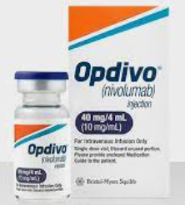
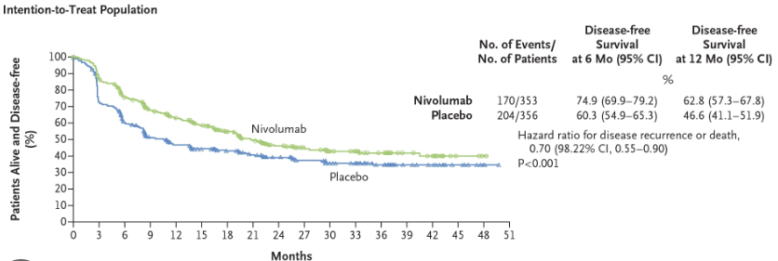
New FDA Approved Treatment of Persistent Invasive Disease After Surgery
For patients after cystectomy with:
pT2 or worse disease (with neoadjuvant chemo)
OR
pT3 or worse disease (without neoadjuvant chemo)
Nivolumab (Opdivo)—PD-1 inhibitor
30% risk reduction of BC recurrence/death (HZ 0.7, 95% CI 0.57-0.86)
IV therapy--every 2-4 weeks x 1 year

Slide 32
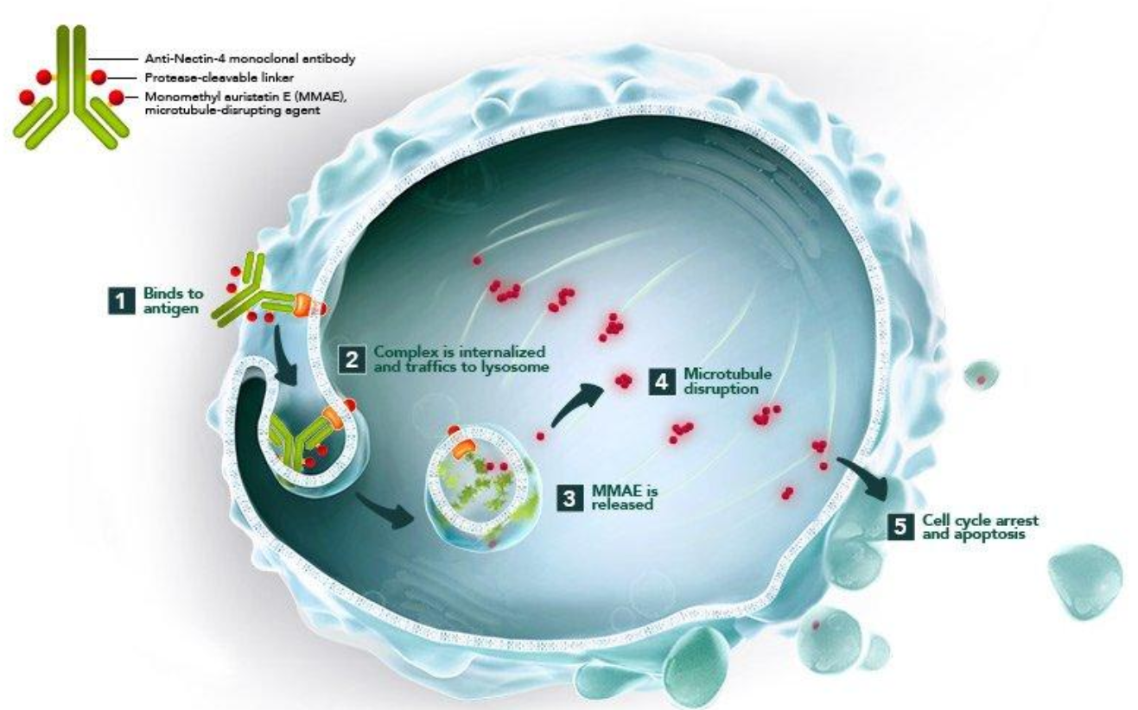
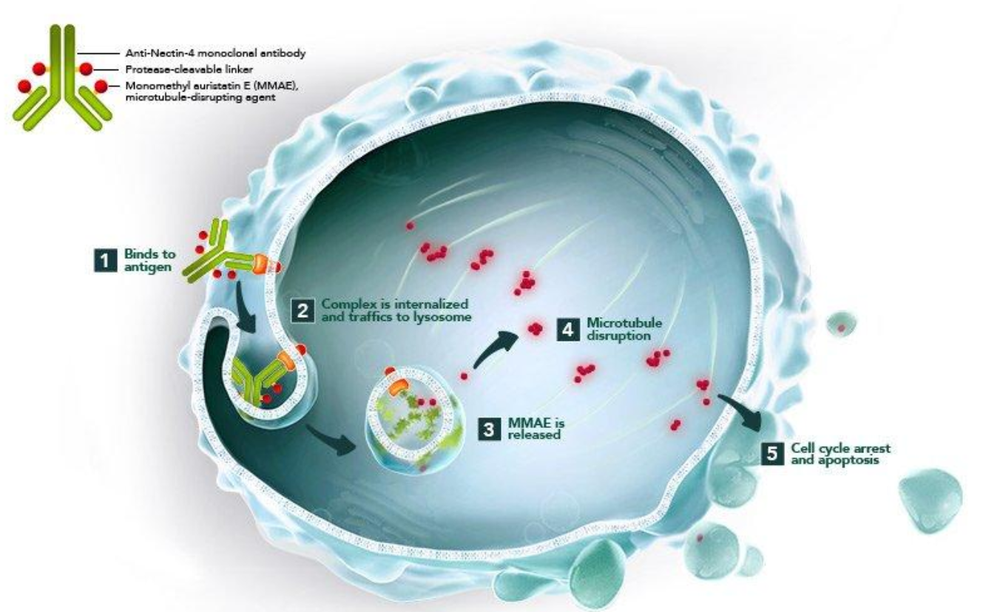
New Standard of Care Locally advanced & Metastatic Urothelial Cancer Cisplatin-ineligible
Traditional regimen: Chemotherapy 6 cycles
-Cisplatin + Gemcitabine vs. ddMVAC
-8,000—9,000 U.S. patients who cannot receive cisplatin therapy
Enfortumab vedotin + Pembrolizumab
Antibody-drug conjugate delivers a precise payload to cancer cells
Binds to nectin-4 protein on cancer cells
Selectively delivers monomethyl auristatin E, killing cancer cells only and sparing normal body cells
12% complete response and 68% partial response rate

Slide 33
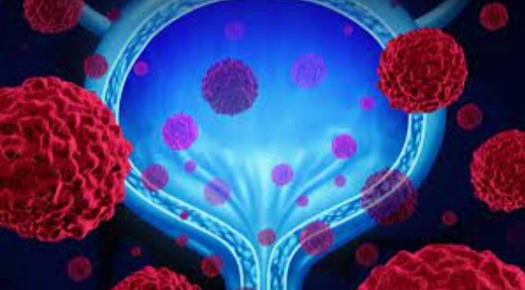
New Frontier: Clinical Trials
Critical component when standard of care treatments are not viable
Non-Muscle Invasive Bladder Cancer
SunRISe 1 –BCG unresponsive high risk CIS +/- pTa disease
TAR-200 (intravesical slow release Gemcitabine) + Cetrelimab
SunRISe 3 –BCG naïve high risk disease
TAR-200/Cetrelimab vs. TAR-200 alone vs. BCG alone
Keynote 676 –BCG naïve or persistent disease
BCG +/- Pembrolizumab
Notes:
Certainly an important element for a comprehensive bladder cancer program is ensuring our patients have access to clinical trials. Clinical trials are a critical….

Slide 34
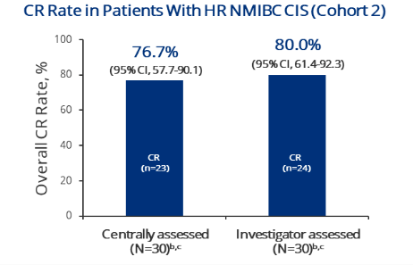
Interim Trial Results – TAR 200
SunRISe 1 –BCG unresponsive high risk CIS +/- pTa disease
Complete response rate = 77%
SunRISe 1 – new cohort: BCG unresponsive high risk pTa disease only
--TAR 200 only (no cetrelimab)

Slide 35
New Frontier: Clinical Trials
Non-Muscle Invasive Bladder Cancer
SunRISe 1 –BCG unresponsive high risk pTa disease
TAR-200 (intravesical slow release Gemcitabine) only
SunRISe 3 –BCG naïve high risk disease
TAR-200/Cetrelimab vs. TAR-200 alone vs. BCG alone
Keynote 676 –BCG persistent disease
BCG +/- Pembrolizumab
PATAPSCO --BCG naïve high risk disease
BCG + Durvalumab
Notes:
Certainly an important element for a comprehensive bladder cancer program is ensuring our patients have access to clinical trials. Clinical trials are a critical….

Slide 36
On the Horizon: Clinical Trials
Non-Muscle Invasive Bladder Cancer
MoonRISe—TAR 210
FGFR alterations in 50-80% of NMIBC
Ertafitinib = oral selective pan-FGFR tyrosine kinase inhibitor approved for metastatic bladder cancer
Ertafitnib has activity in HR and IR NMIBC
Notes:
Certainly an important element for a comprehensive bladder cancer program is ensuring our patients have access to clinical trials. Clinical trials are a critical….

Slide 37
New Frontier: Clinical Trials
Critical component when standard of care treatments are not viable
Muscle Invasive Bladder Cancer
SunRISe 2 –unfit or unwilling for cystectomy
TAR-200 + Cetrelimab vs. Chemotherapy/Radiation
SunRISe 4 –ineligible for Cisplatin based chemotherapy
Cetrelimab +/- TAR-200 prior to cystectomy
Notes:
Certainly an important element for a comprehensive bladder cancer program is ensuring our patients have access to clinical trials. Clinical trials are a critical….

Slide 38
First Bladder Cancer Walk in Denver No one walks alone
Register as an individual. Or create a team! www.bcanwalk.org

Slide 39
Bladder Cancer Support Group Colorado Urology
Semi-annual meetings (May/November)
Next meeting May 2024
Meeting topics
What do you want to learn about?
Upcoming clinical trials and therapeutics
Ostomy tips/tricks
Pelvic floor physical therapy
Ways to mitigate side effects of intravesical therapy
Novel treatments for metastatic bladder cancer

Slide 40
www.coloradouro.com
Thank you!

